Slide 1
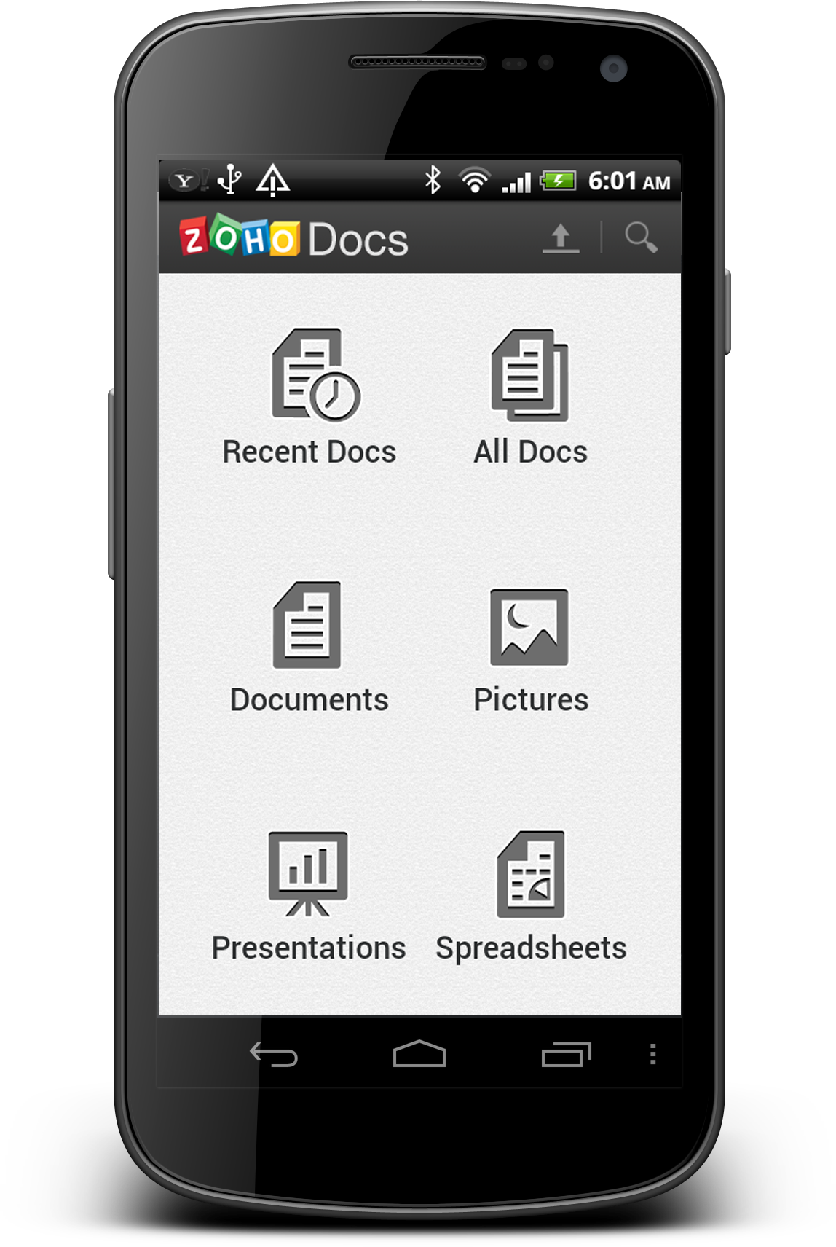
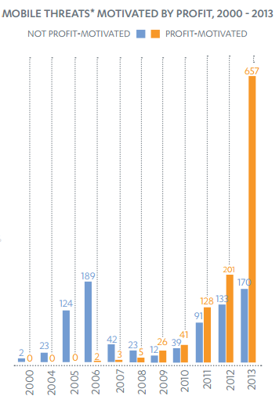
NetDroid:
Malware Detection via Application Profiling based on Network Connections
Jesse English, Hugo González, Abdullah Alzahrani, Natalia Stakhanova, Ali Ghorbani
Faculty of Computer Science, University of New Brunswick
The Problem
The Overview
In 2013, 97% of new mobile malware was targeted at the Android platform
Between 2000 and 2012, 1,238 Android-specific threats
In 2013 - over 800 new threats emerged
The vast majority of malware for Android is in the form a trojanized popular applications. In other words, malicious code is added to legitimate apps. This repackaged app is then put back online for unsuspecting victims to download and infect their device.
NetDroid is an Android application which quietly runs in the background of a device.
By tracking and analyzing every outbound connection for each installed application, NetDroid can build a profile for every app, based on its individual network behaviour. Once a profile is built, NetDroid can determine when that particular app deviates from its profiled behaviour.
Since a change in behaviour could mean that the app is infected, NetDroid notifies the device’s owner of the suspicious application.
The Objectives
The Details
To detect malicious applications, in spite of the constrained resources on Android, by:
Building profiles for each application installed on an Android device based on the app’s network connections.
Then attempting to detect when an application changes connection patterns as this could be an indication that the app has been infected with malware.
Assumption: when a legitimate app is repackaged with malicious code, it will likely connect to new and/or different addresses than the legitimate one.
NetDroid is an application which monitors network connections based on connection’s stability, consistency, and longevity.
After collecting this data for an extended period of time, specific profiles are built for each application being monitored. This profile includes, among other calculations, the average number of daily connections, specific IP-to-App relationships, and a measurement of the consistency of the application’s connectivity.

